Slide 1
Machine learning wine predictions
Dan Bruen, Filipa Correia, Eddy Joseph, Gage petruzello, alec Prostok

Slide 2
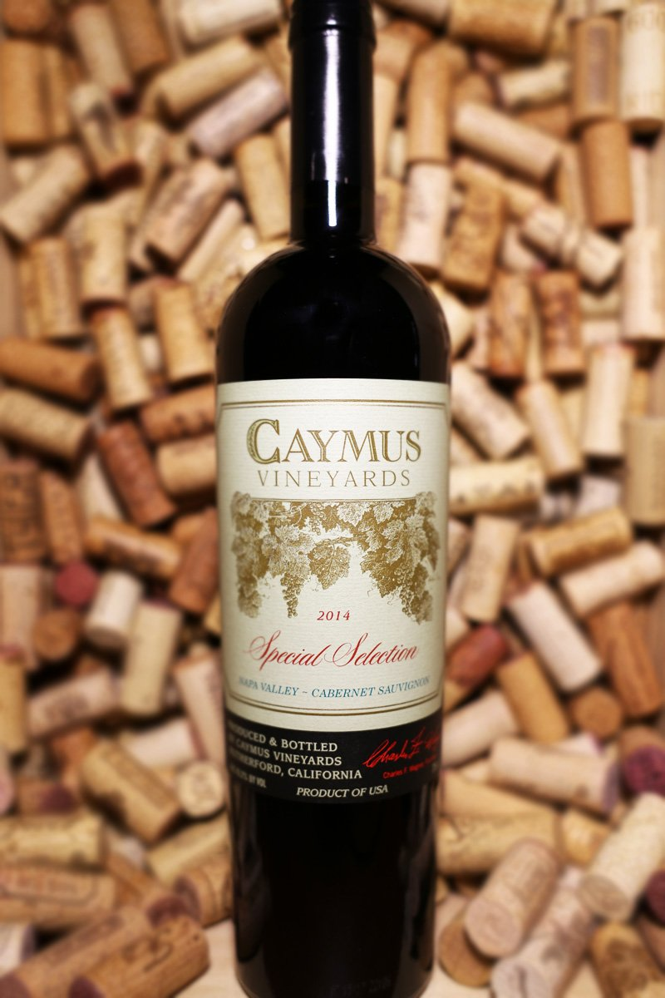
Goals & objectives
Create a machine learning model that analyzes existing wine data to make a classification on high-quality wine.
Develop a descriptive ‘search’ function that allows you to describe a wine you’re seeking and return the ‘quality’ bucket of the wine you’re enjoying.

Slide 3
Existing Data used
We used a data set of over 125,000 wines from 36 different countries.
The data contained information on the various wines’ points, varietal, region and price.
The data set was scraped from ‘wine enthusiast’ magazine.
We parsed our data set down to ~18,000 wines

Slide 4
Existing data used

Slide 5
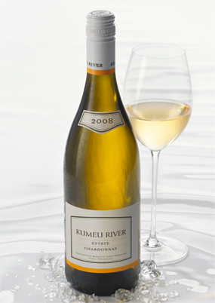
The machine learning model we created
Random Forest Classifier
We used 5 ‘quality’ bins to describe the wine
We also used a count vectorizer on the wine description, the country of origin and the variety of the grape.
The other feature used was the price.
The Random Forest Classifier predicts the quality of the wine in terms of the 5 pre-established bins.
The model had a score with the testing data of ~95

Slide 6
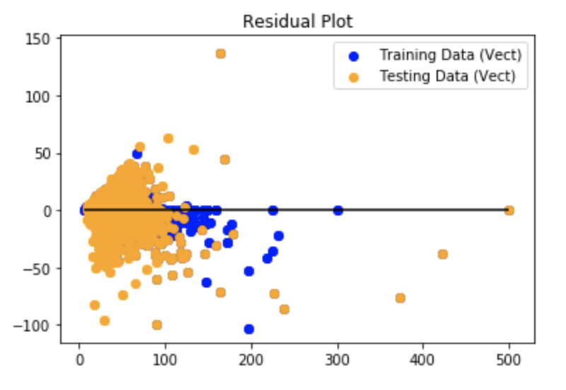
The machine learning model we created
Random Forest Regressor
We used the same vectorizer in the same features with this model (wine description, the country of origin and the variety of the grape). The other feature here was the points of the wine.
The Random Forest Regressor predicts the price of the wine.
This model fared worse than the Random Forest Classifier, with a score of the testing data of ~68 (~94 with the training data).
We then added two features to the vectorizer: the region and the winery of the wine. The score of the testing data was ~81

Slide 7
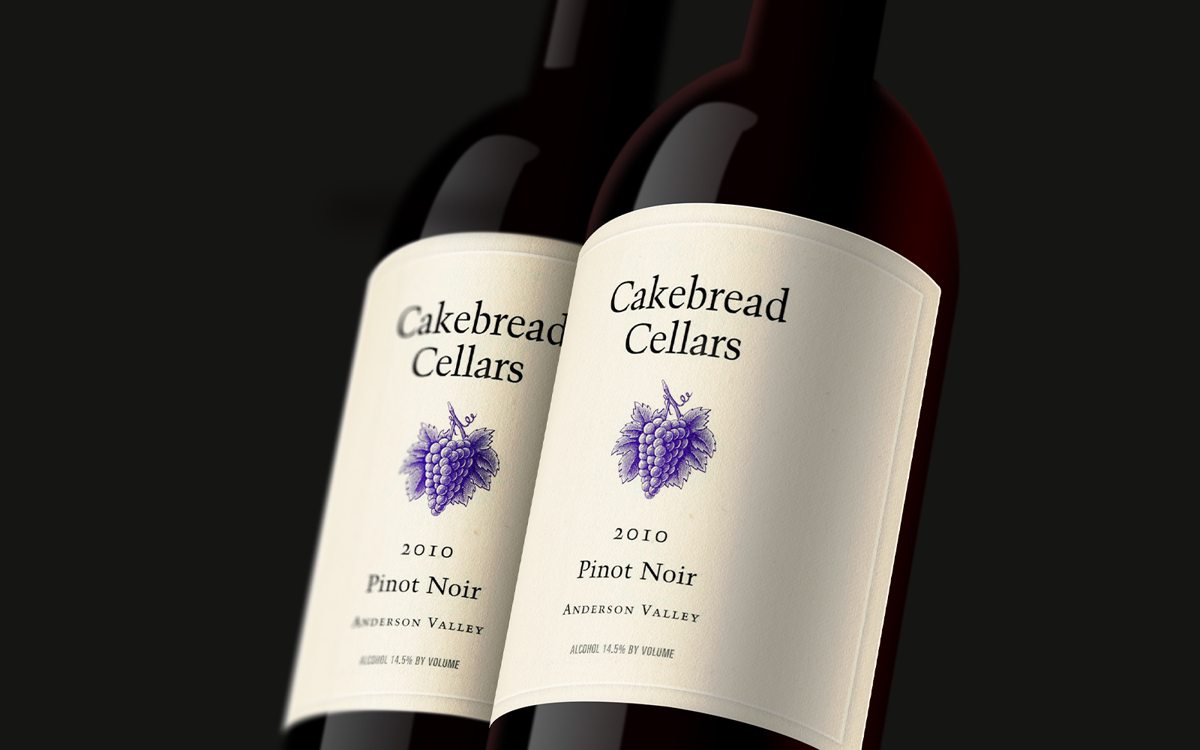
Our process & the challenges we faced
The testing data we used was skewed towards more expensive wine – the lowest rated wine was 80 points (out of a possible 100 points)
We wanted to be able to pull a specific wine or wines from the data set that match your description of the wine you’re looking for.
We think there are additional features/steps needed to refine the model. There may be other information that is not currently in the model that adds to the predictive ability.

Slide 8
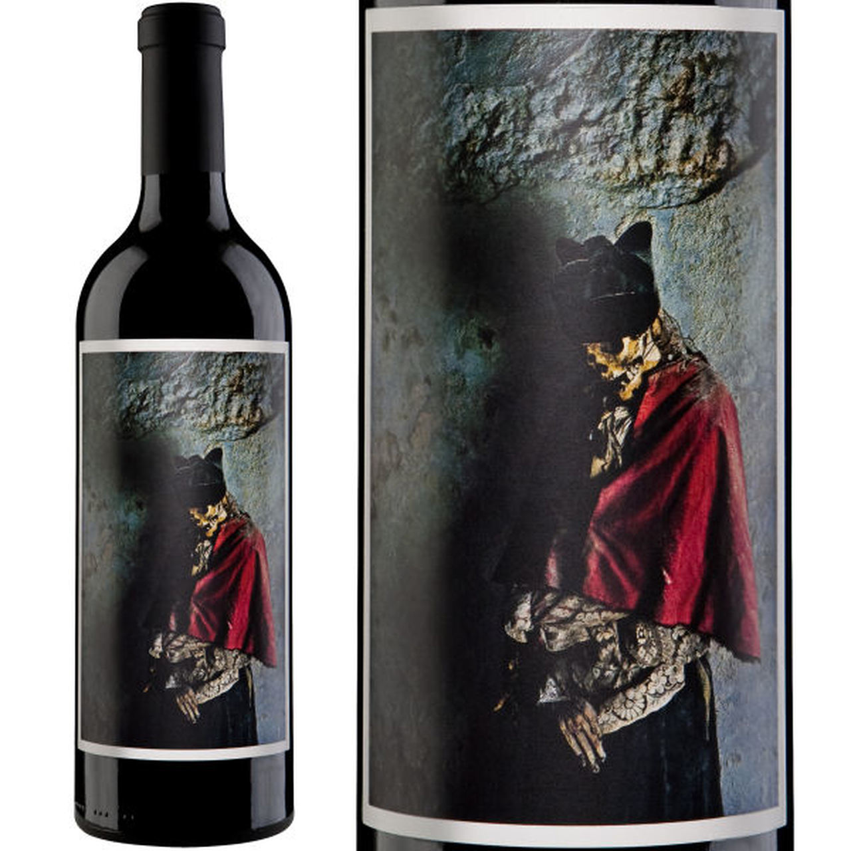
Future improvements
Rather than just vectorizing and binning the wine, we would like to ultimately return specific wines from the data.

